Slide 1
ARCADE Machine
Nada Samir – Nour eldin Ibrahim
20100752 - 20101066

Slide 2
CONTENTS OF THIS TEMPLATE
Arcade brief history.
Purpose of project
Arcade Design.
Components and Connections.
Goals

Slide 3
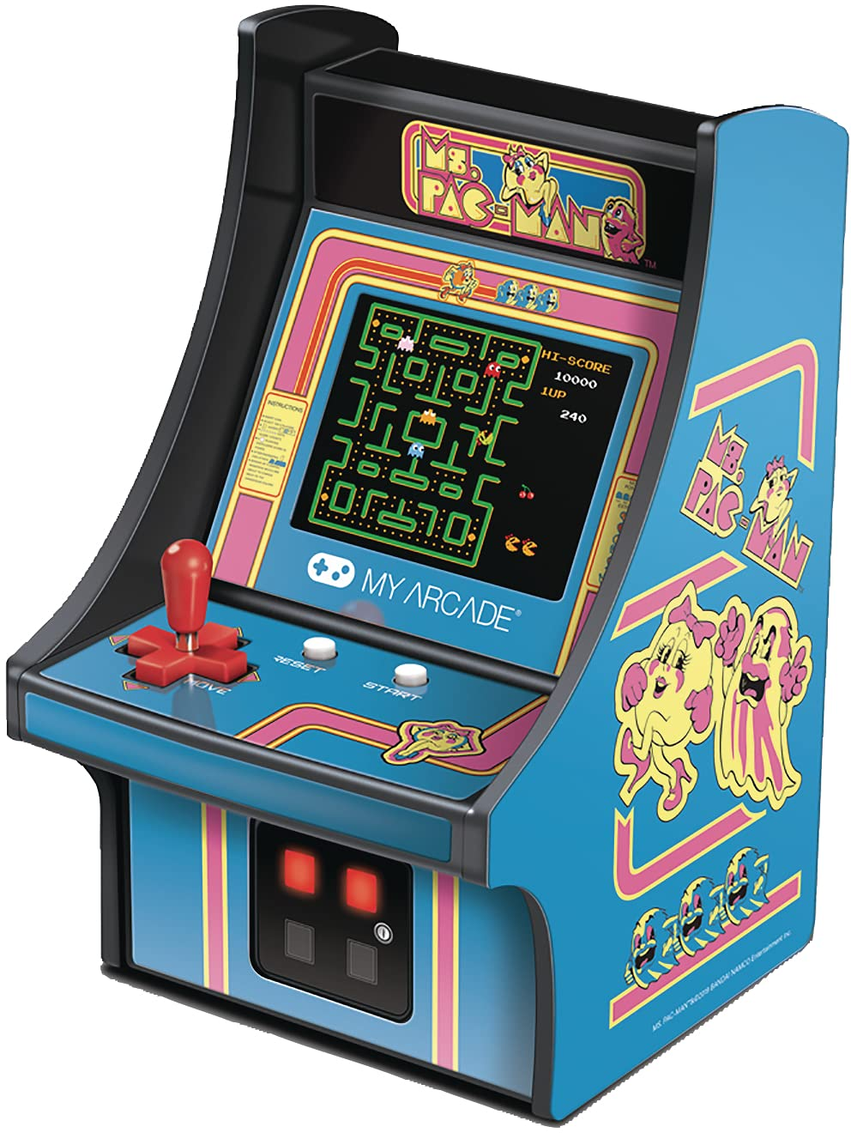
Arcades Brief History
Arcade game is an amusement machine that was designed to play one game, it was used to be famous in the 1970s, and its popularity started fading out since the manufacture of video game consoles.

Slide 4
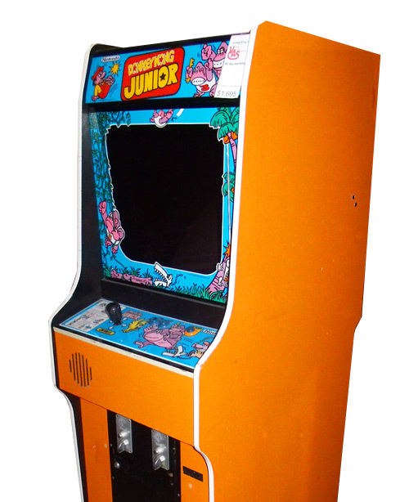
Purpose
Entertainment and enjoyment for 90s kids.
Bringing back gaming legacy.

Slide 5
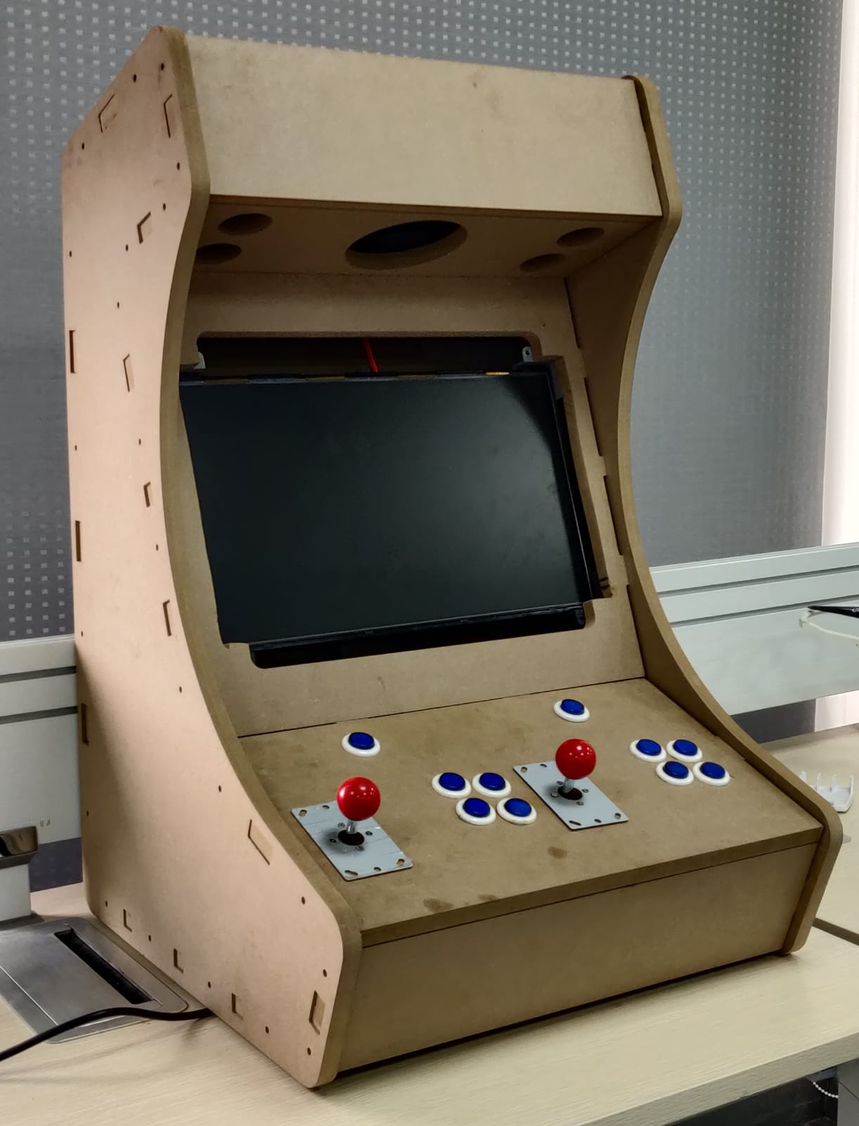
Arcade Design
We selected an CNC bartop arcade design for 2 players from websit “Grab Cat”
Website: https://grabcad.com

Slide 6
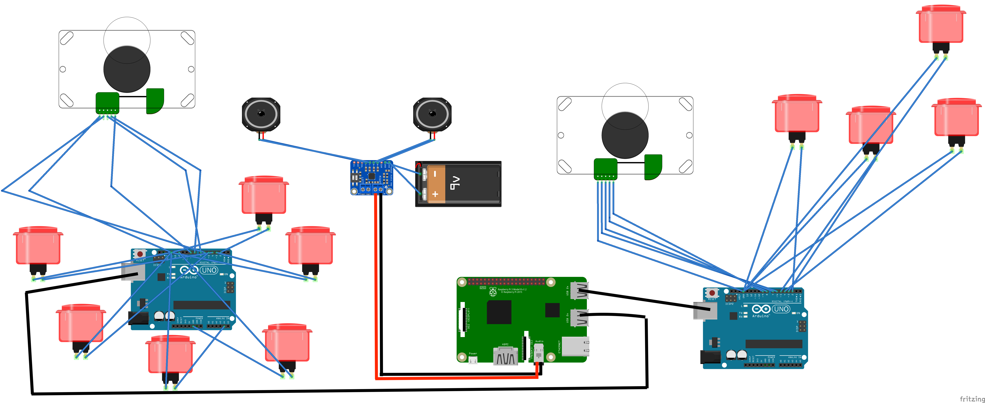
Components and Connections
We designed a multi retro console game as Atari or Nintendo Entertainment System for two players using an emulator called “Recall Box” on a raspberry pi which is connected to:
_A LCD monitor.
_Speakers.
_Arduino encoders.
_Push buttons and the joysticks.

Slide 7
Goals
Make it a portable Arcade.
Decode both player signals on single encoder.
Mount a payment method (coin acceptor).
Implement mobile casting in addition with joysticks.

Slide 8
Thank You

